Slide 1
Emojize
Social media minus the toxicity, with the help of AI.
Code For Good 2023 | Team SRX

Slide 2
Table of contents
01
02
03
04
Introduction →
Problem and Solution →
Market Opportunity →
Prototype Demo →

Slide 3
01
Introduction →

Slide 4

Emoji + Energize = Emojize
Using semantic analysis to ensure a safe space for people struggling with their mental health to recharge without stress.

Slide 5
Why Emojize?
Negative Effects of Social Media
Many researchers conclude that there is a positive correlation between social media usage and depression. Approximately 9.5% of American adults ages 18 and over will suffer from a depressive illness each year.
Positive Effects of Social Media
For individuals struggling with depression, social media serves a much-needed outlet for emotional expression and support. It offers a safe haven for those too fatigued to socialize in person, helps them manage their intense emotions, and provides a discreet refuge when guilt or fear of judgment keeps them from confiding in offline friends or seeking costly professional help.

Slide 6
02
Our Solution →

Slide 7
What is Emojize?
Emojize provides a fully anonymous, communicative, toxicity free safe space.
Emojis instead of usernames for anonymity
“Emoji Lobbies” - Chat rooms themed around different emotions
Machine learning network LSTM hides inappropriate posts and recommends Emoji Lobbies based on the connotation of a post

Slide 8
How Emojize Works
Long Short-Term Memory
Cell state
Traditional RNNs are unable to process longer text sequences due to a vanishing gradient problem.
LSTMs (Long Short-Term Memory) are designed to overcome these limitations. Using an LSTM with a word vector embedding, we analyze and interpret patterns in user language.
x
+
x
tanh
σ
σ
tanh
σ
x
Hidden state

Slide 9
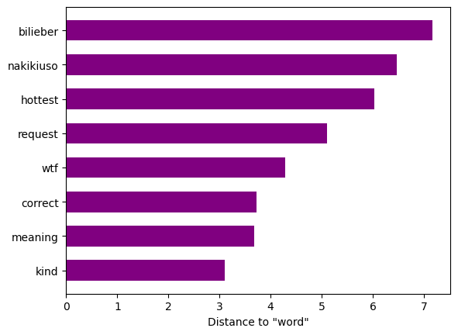
Word Embedding
Every word is a vector.
Word vectors capture the relationships and contexts of words based on their usage within a large corpus of text.
The vector encoding of “Word” is closer to “Meaning” than to “Nakikiuso”.

Slide 10
03
Market Analysis →

Slide 11
Digital Mental Health Market
Insights and Forecast
The digital mental health market size was valued at $19.5 billion in 2022 and is projected to grow grow to $72.3 billion by 2032 with a CAGR of 20.6%.
The industry has been segmented into patients, payers, and providers, with patients holding the most prominent segment revenue share in 2022. The rising prevalence of mental illness, especially in the remission period of the COVID-19 pandemic, fuels the demand and growth of affordable and accessible mental health tools.

Slide 12
Potential for Emojize
Target Market
Children and adolescents comprise the majority of mental health diagnoses and a large part of social media users. The intersection and correlated growth in the prevalence of social media usage and mental disorders in these demographics provide a concrete foundation for market growth.
Opportunity
Increasing market size for mental health platforms promotes the entry of newer companies, propelled by the rising awareness and acceptance of digital health technology. Existing industry players are implementing various strategies to strengthen their position in the market, including advanced solutions to meet end-customer needs.

Slide 13
04
Prototype Demo →

Slide 14
Emogize Demo

Slide 15
Sources
https://www.hopkinsmedicine.org/health/wellness-and-prevention/mental-health-disorder-statistics#:~:text=Approximately%209.5%25%20of%20American%20adults,from%20major%20depression%20than%20men
https://pubmed.ncbi.nlm.nih.gov/23260846/
https://www.ncbi.nlm.nih.gov/pmc/articles/PMC4853817
https://www.researchgate.net/publication/354545789_Hate_Speech_and_social_media_A_Systematic_Review
https://www.marketresearchfuture.com/reports/digital-mental-health-market-11062

